Slide 1

CSCI-3753: Operating Systems Spring 2021
Biljith Thadichi
Department of Computer Science University of Colorado Boulder
Slides based on presentation by Abigail Fernandes
CSCI 3753 Spring 2021

Slide 2
Week 6
> Shared memory
> Reentrant and Threadsafe code
> PA2 questions
CSCI 3753 Spring 2021
3

Slide 3
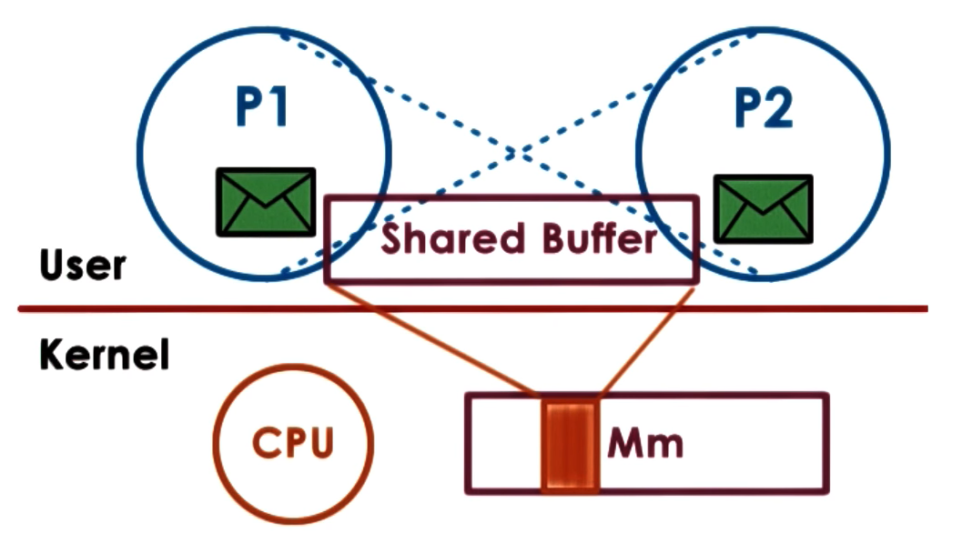
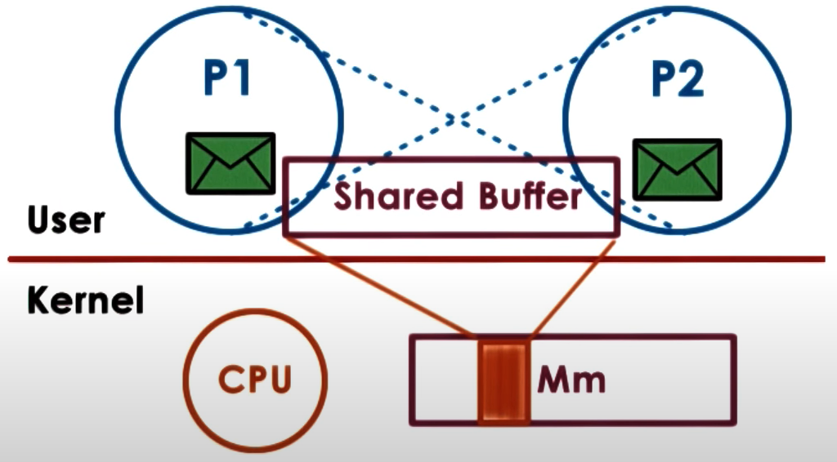
Shared memory
Read / Write to Shared Memory
OS establishes the channel
Different virtual addresses mapped to the same physical address
CSCI 3753 Spring 2021

Slide 4


Shared memory
Explicit synchronization
Shared buffer management and communication protocol is programmer’s responsibility
System calls only for setup
Large amounts of data can be exchanged
CSCI 3753 Spring 2021

Slide 5
Shared Memory
Create a shared memory segment or get the ID of an existing shared segment
int shmget(key_t key, size_t size, int shmflg);
Other processes (if permitted) can access.
Library: sys/ipc.h and sys/shm.h
key: a value used to share between processes
size: size of the shared memory segment
shmflg: options for segment creation
CSCI 3753 Spring 2021

Slide 6
Shared Memory
Attach the shared segment to a process address space
void *shmat(int shmid, const void *shmaddr,…
int shmflg);
Once attached, a process can read or write to the segment.
Library: sys/types.h and sys/shm.h
shmid: id of the shared memory segment
shmaddr: address in the process space
shmflg: options for shared memory permission
CSCI 3753 Spring 2021

Slide 7
Shared Memory
Detach the shared memory segment located at the
shmaddr address
int shmdt(const void *shmaddr);
Library: sys/types.h and sys/shm.h
shmaddr: attaching address in the process space
CSCI 3753 Spring 2021

Slide 8








Shared Memory Example
Process SERVER
Write
Process CLIENT
Read
Code
Code
Data
Data
shmaddr
shmaddr
Heap
Heap
Key = 5678
Key = 5678
Stack
Shared Memory
Stack
CSCI 3753 Spring 2021

Slide 9
Week 5
> Shared memory
> Reentrant vs Threadsafe
> PA2 questions
CSCI 3753 Spring 2021
3

Slide 10
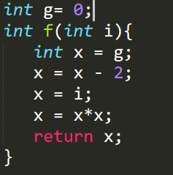
Reentrant? Threadsafe?
CSCI 3753 Spring 2021

Slide 11
Reentrant? Threadsafe?
Reentrant and threadsafe. The global variable isn’t modified. Only local variable x is being modified
CSCI 3753 Spring 2021

Slide 12
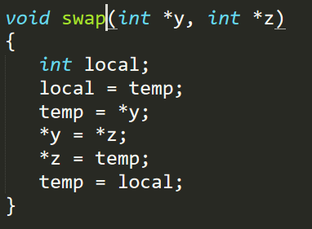
Reentrant? Threadsafe?
Here temp is global
CSCI 3753 Spring 2021

Slide 13
Reentrant? Threadsafe?
Here temp is global
Reentrant but not threadsafe. Think of what could go wrong with the global variable temp if multiple threads were executing.
CSCI 3753 Spring 2021

Slide 14
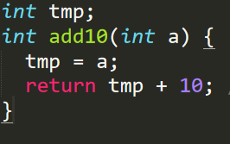
Reentrant? Threadsafe?
CSCI 3753 Spring 2021

Slide 15
Reentrant? Threadsafe?
Not Reentrant or threadsafe.
CSCI 3753 Spring 2021

Slide 16
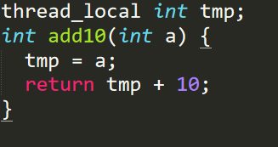
Reentrant? Threadsafe?
thread_local here means that the variable tmp is local to the thread and isn’t shared between threads.
CSCI 3753 Spring 2021

Slide 17
Reentrant? Threadsafe?
Threadsafe but not reentrant.
CSCI 3753 Spring 2021

Slide 18
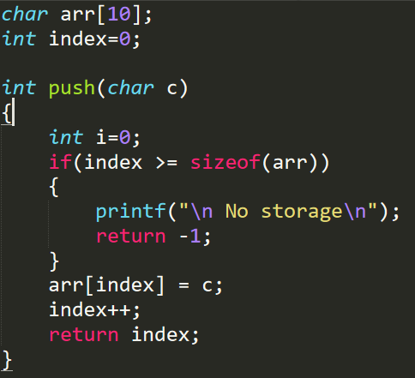
Reentrant? Threadsafe?
CSCI 3753 Spring 2021

Slide 19
Reentrant? Threadsafe?
Not threadsafe or reentrant.
CSCI 3753 Spring 2021

Slide 20
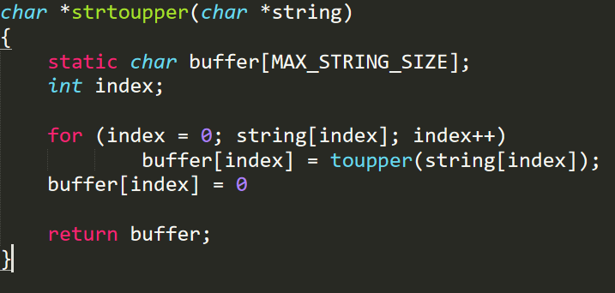
Reentrant? Threadsafe?
Not threadsafe or reentrant.
Source. This also has a lot of other examples if you are still confused.
CSCI 3753 Spring 2021

Slide 21
Reentrant? Threadsafe?
Not threadsafe or reentrant.
CSCI 3753 Spring 2021

Slide 22
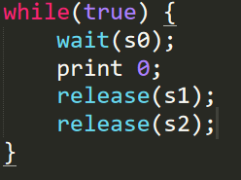


How many times is the print statement executed
Initial values: S0 = 1; s1 = 0; s2 = 0;
P0
P1
P2
A. At least twice
B. Exactly twice
C. Exactly thrice
Exactly once
CSCI 3753 Spring 2021

Slide 23
How many times is the print statement executed
Initial values: S0 = 1; s1 = 0; s2 = 0;
P0
P1
P2
A. At least twice
B. Exactly twice
C. Exactly thrice
Exactly once
CSCI 3753 Spring 2021

Slide 25
Week 6
> Shared memory
> Reentrant vs Threadsafe
> PA2 questions
CSCI 3753 Spring 2021
3

Slide 26
Week 6 – Checklist
Complete this week’s quiz
Sign up for Interview grading slots
Finish PA2
Have a great weekend!
CSCI 3753 Spring 2021
17

